Slide 1


Kadi Sarva Vishwavidyalaya
B. P. College of Computer Studies-BCA
BCA SEMESTER-VI
BCA-607
PROJECT PHASE-II
“RESTAURANT MANAGEMENT SYSTEM”
STUDENT NAME | ROLL NO. | ENROLLMENT NO.
CHAVADA YASHRAJ | 22I009 | 22BCA04
NAYI KISHAN | 22I031 | 22BCA04228
VAGHELA DASHRATH | 22I067 | 22BCA04552

Slide 2
SR. NO | CONTENT NAME | SLIDE NO.
1. | Title | 3
2. | Project Definition | 3
3. | Project Scope / Project Objective | 4
4. | Technology Used | 3
5. | Study of Existing System | 4
6. | Advantages & Disadvantages of Existing System | 6
7. | Operational Level Problems, Technical Level Problems, Information Level Problems | 7-9
8. | Proposed system | 10
9. | Proposed system advantages and disadvantages | 11-12
10. | SRS including functional requirement and non-functional requirement | 13-14
11. | Feasibility study (Operational ,Technical , Economical and scheduled) | 15-18
12. | Proposed system modules | 19-24
13. | Screen Designing | 25-27
14. | ER- Diagram | 28
15. | Context, First And Second Level DFD | 29-31
16. | Data Dictionary | 32-38
17. | Admin Panel | 39-67

Slide 3
Proposed System
Title:- Restaurant Management System
Aim:-To streamline and optimize restaurant operations, enhancing efficiency, improving customer satisfaction, and increasing profitability.
Scope Of Restaurant Management System
The scope of a restaurant management system includes managing daily operations, inventory, staff scheduling, and financials, while improving order accuracy and customer satisfaction. It also supports marketing, promotions, compliance, and data analytics for informed decision-making and strategic growth.

Slide 4
Development Tools & Technology Used
Front-end
  Html :- To design a web page.
  Css :- To give elegant of website.
  Java script :- To make dynamic website
  Back-end
  PHP :-To implement the basic logic.
  Mysql :-The database of project.

Slide 5
Study of Existing System
A Restaurant Management System (RMS) is a comprehensive software solution designed to manage and streamline various operational aspects of running a restaurant
Identify key functionality and workflows.
Efficiently takes and manages customer orders, ensuring accuracy and speed in service.
Identify the projects.
The Primary purpose of a restaurant management system is to centralize and simplify the management of all the restaurants operations, leading to increased efficiency, improved customer satisfaction, reduced operational costs, and better data-driven decision-making.

Slide 6
Advantage of Existing System
Integration with Third-party Services:
  Connects with payment gateways and delivery services.
Inventory Control:
  Tracks stock levels and reduces waste.
Employee Management:
  Simplifies scheduling and automates payroll.
Enhanced Security:
  Ensures secure payments and data protection.
Customer Engagement:
  Manages loyalty programs and collects feedback.
Improved Customer Experience:
  Reduces wait times and personalizes service.
Cost Management:
  Optimizes inventory and labor costs.
Data-driven Decision Making:
  Provides detailed sales and operational reports.
Scalability:
  Supports expansion and integrates new services.

Slide 7
Disadvantage of Existing System
High Initial Cost:
  Significant upfront investment.
Complex Implementation:
  Time-consuming setup.
  Requires staff training.
Dependency on Technology:
  Vulnerable to system failures.
  Needs reliable internet.
Maintenance Costs:
  Ongoing software updates and support.
  Potential IT staff requirements.
Data Security Risks:
  Vulnerable to cyber attacks.
  Requires strong security measures.
Integration Challenges:
  Difficulties with existing systems.
  Compatibility issues..
Customization Limitations:
  May not meet all specific needs.
  Limited feature customization.
Data Privacy Concerns:
  Responsible data handling required.
  Compliance with regulations.

Slide 8
Operational Level Problems
1. Inventory Management
Problem: Difficulty in tracking inventory levels, leading to overstocking or stockouts.
2. Staffing Issues
Problem: Inconsistent staffing levels, high turnover, and inadequate training.
3. Food Quality Control
Problem: Maintaining consistent food quality and presentation.
4. Customer Service
Problem: Ensuring consistent and high-quality customer service.
5. Health and Safety Compliance
Problem: Ensuring compliance with health and safety regulations.

Slide 9
Information Level Problem
1. Data Collection Inconsistencies
Problem: Inconsistent data collection methods leading to unreliable data.
2. Inefficient Data Storage
Problem: Poor data storage practices causing difficulties in retrieving information.
3. Lack of Real-Time Data Access
Problem: Inability to access real-time data for making timely decisions.
4. Lack of Integration with Suppliers
Problem: Difficulty in managing supplier information and coordinating orders.
5. Customer Relationship Management
Problem: Inability to track and enhance customer relationships effectively.

Slide 10
Proposed System
A comprehensive system to manage reservations, orders, inventory, billing, and customer relations, accessible via website.
Advantage of Propose System :
1. 24/7 Accessibility
Anytime, Anywhere Access: Manage restaurant operations from any location at any time, allowing for greater flexibility and control.
Remote Monitoring: Track real-time data and reports remotely, facilitating proactive management and decision-making.
2. Enhanced Customer Convenience
Online Reservations: Customers can book tables online, check availability, and receive instant confirmations, improving their overall experience.
Online Ordering: Facilitates online orders for takeout and delivery, providing customers with a convenient way to order food.
3. Efficient Order Processing
Real-Time Order Management: Orders placed online are directly sent to the kitchen, reducing wait times and improving order accuracy.
Integrated Payment Gateway: Secure and efficient online payment options streamline the payment process for both customers and the restaurant.
4. Improved Marketing and Customer Engagement
Email and SMS Campaigns: Easily set up and manage marketing campaigns, promotions, and updates to engage customers and drive sales.
Loyalty Programs: Implement online loyalty programs to reward repeat customers and encourage brand loyalty.
5. Enhanced Security
Data Encryption: Protect sensitive information through secure, encrypted connections.
Regular Backups: Automated data backups ensure that information is always safe and can be restored if necessary.

Slide 11
Disadvantage of Propose System :
1.Dependence on Internet Connectivity: Online RMS require a stable internet connection. Without it, you might experience downtime or be unable to access important data.
2.Security Concerns: Storing data online can be risky if the system is not properly secured. There is a potential for data breaches or unauthorized access if cybersecurity measures are inadequate.
3.Data Privacy Issues: Handling sensitive or confidential data online may raise privacy concerns, especially if data is stored on servers in different jurisdictions with varying privacy laws.
4.Performance Issues: The performance of online RMS can be affected by server load or bandwidth limitations, potentially leading to slower response times or system lag.
5.Dependency on Vendor: You're reliant on the service provider for system updates, support, and overall system reliability. If the vendor experiences issues or discontinues the service, it can impact your operations.

Slide 12
Software Requirement Specification
Customer-Side Requirements
Operating System:
Windows 10 or later (for desktop users)
macOS 10.12 or later (for Mac users)
Browser:
Google Chrome, Firefox, Microsoft Edge
RAM (Memory):
4 GB RAM.
8 GB RAM
Storage (ROM):
512 MB to 1 GB free space for cached data, browsing data, etc.

Slide 13
Software Requirement Specification
Admin-Side Requirements
Operating System (OS):
Windows 10/11 or higher for PCs.
macOS 10.13 (High Sierra) or later for Mac users
2. RAM (Memory):
8 GB RAM
16 GB RAM
3. Storage (ROM):
256 GB SSD
512 GB SSD
4. Web Browser:
Google Chrome, Firefox, Safari, or Microsoft
7. Security:
Anti-virus Software
Firewall and VPN

Slide 14
Functional requirement :
1.Resource Scheduling and Allocation:
Online Booking: Users should be able to book and allocate resources online through an interface.
Availability Checking: The system should display real-time availability of resources to prevent scheduling conflicts.
2.User Management:
User Registration and Authentication: Support for user registration, login, and secure authentication.
Role-Based Access Control: Different access levels for administrators, managers, and regular users, with permissions assigned based on roles.
3.Resource Tracking:
Real-Time Tracking: Monitor the status and usage of resources in real-time.
Status Updates: Allow users to update the status of resources (e.g., available, in use, under maintenance).
4.Reporting and Analytics:
Customizable Reports: Generate reports on resource utilization, costs, and other metrics.
Dashboard Analytics: Provide dashboards with visual analytics and summaries of key performance indicators.
5.Integration Capabilities:
API Integration: Support for integrating with other systems (e.g., CRM, ERP) via APIs.
Data Import/Export: Features for importing and exporting data in various formats (e.g., CSV, Excel).

Slide 15
Non-Functional requirement :
1.Portability:
Cross-Platform Compatibility: The system should work across various operating systems and devices, ensuring broad accessibility.
Deployment Flexibility: The system should be deployable in different environments (e.g., cloud, on-premises) with minimal adjustments.
2.Backup and Recovery:
Data Backup: Implement regular, automated backups to prevent data loss.
Disaster Recovery: Have a disaster recovery plan to restore functionality in case of a major failure or data loss.
3.Interoperability:
Integration Support: The system should integrate smoothly with other software and systems (e.g., CRM, ERP) via standard protocols and APIs.
Data Exchange: Facilitate data exchange using common formats (e.g., JSON, XML).
4.Efficiency:
Resource Utilization: Optimize the use of system resources (e.g., CPU, memory, bandwidth) to reduce costs and improve performance.
Energy Efficiency: Implement energy-efficient practices where applicable, especially in cloud environments.
5.Support and Training:
Customer Support: Offer reliable support channels (e.g., chat, email, phone) to assist users with issues.
Training Resources: Provide training materials and resources to help users understand and effectively use the system.

Slide 16
Feasibility Study
The objective of feasibility study is to determine whether or not the proposed system is feasible.
The feasibility is determined is terms of four aspects.
These are:-
OPERATIONAL FEASIBILITY STUDY
TECHNICAL FEASIBILITY STUDY
ECONOMICAL FEASIBILITY STUDY
SCHEDULE FEASIBILITY STUDY

Slide 17
TECHNICAL FEASIBILITY STUDY
A technical feasibility study for an online restaurant management system assesses whether the chosen technology can support functions like order processing, inventory management, and customer interaction. It examines the technology stack, integration with existing systems (e.g., POS), scalability for handling peak times, security for protecting customer data, and the expertise required for development and maintenance. The study ensures that the system can be effectively built and operated to meet the restaurant’s operational needs.
OPERATIONAL FEASIBILITY STUDY
An operational feasibility study for an online restaurant management system evaluates how well the system integrates into daily operations. It assesses whether the system meets user needs, is easy to use, and aligns with restaurant workflows. The study also considers the training required for staff, the impact on existing processes, and the support needed for ongoing maintenance. The goal is to ensure that the system improves operational efficiency and can be smoothly adopted by the restaurant.

Slide 18
ECONOMICAL FEASIBILITY STUDY
An economic feasibility study for an online restaurant management system examines the financial aspects of the project. It estimates costs for development, deployment, and maintenance, and compares these against potential benefits, such as increased efficiency and revenue. The study evaluates the return on investment (ROI) and ensures the project is financially viable within the restaurant's budget, justifying the expense with expected financial gains.
SCHEDULE FEASIBILITY STUDY
A schedule feasibility study for an online restaurant management system assesses if the project can be completed within the desired timeframe. It involves creating a detailed timeline for development, testing, and deployment, and evaluating if the necessary resources and milestones can be met on schedule. The study ensures that the system will be ready for use when needed, without causing disruptions to the restaurant’s operations.

Slide 19
SCHEDULE FEASIBILITY STUDY
A schedule feasibility study for an online restaurant management system assesses if the project can be completed within the desired timeframe. It involves creating a detailed timeline for development, testing, and deployment, and evaluating if the necessary resources and milestones can be met on schedule. The study ensures that the system will be ready for use when needed, without causing disruptions to the restaurant’s operations.

Slide 20
Modules Of Proposed System
Home Page Module:
Overview of the restaurant with key features and promotions.
Easy navigation to other sections.
Menu Management Module:
Display and update menu items, including descriptions, prices, and images.
Option for daily specials or limited-time offers.
Online Ordering Module:
User-friendly interface for placing orders.
Customization options for menu items (e.g., toppings, dietary preferences).
Reservation System Module:
Online table booking with real-time availability.
Confirmation and reminder notifications.
Customer Accounts Module:
User registration and login for managing orders and reservations.
Order history and saved preferences.

Slide 21
Modules Of Proposed System
Payment Processing Module:
Secure online payment options (e.g., credit/debit cards, digital wallets).
Integration with payment gateways.
Reviews and Ratings Module:
Allow customers to leave reviews and rate their experience.
Display reviews and feedback on the site.
Promotions and Discounts Module:
Manage and display current promotions, discounts, and coupon codes.
Integration with marketing campaigns.
Contact and Support Module:
Contact forms, live chat, or support ticket system.
Provide information about the restaurant, including location and hours.

Slide 22
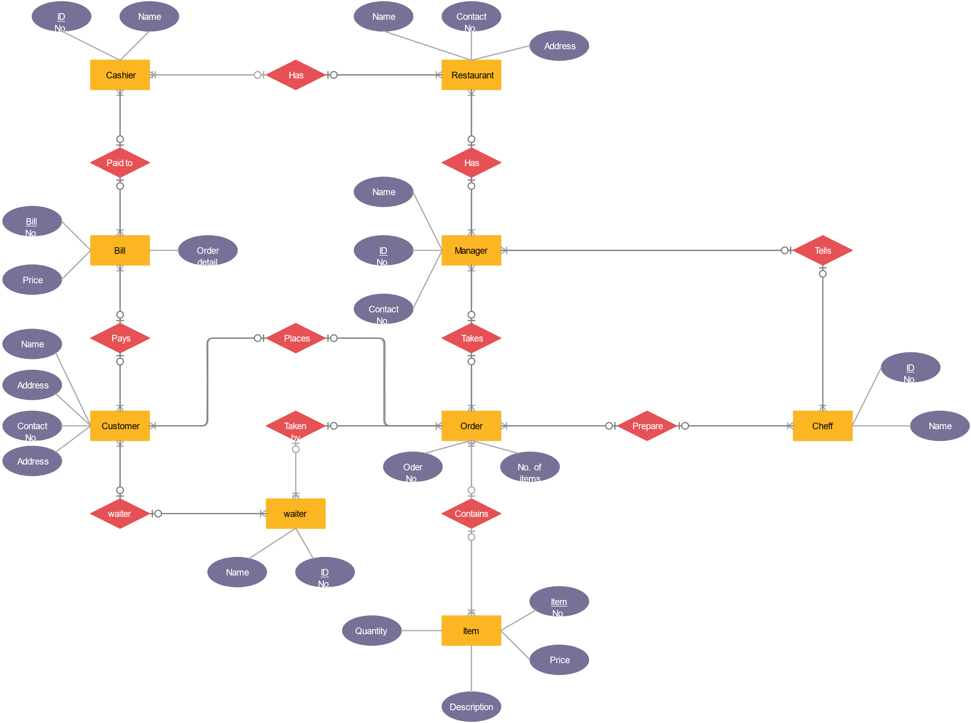
E-R Diagram :

Slide 23
Data Dictionary:

Slide 24
Customer :
Field Name | Data Type | Constraints | Description
Customer_ID | Integer | Primary | Unique identifier for each customer.
Customer_Name | Varchar | Not Null | Full name of the customer.
Phone_Number | Integer | Not Null | Contact number of the customer.
Email_Address | Varchar | Not Null | Email address of the customer.
Address | Varchar | Not Null | Residential address of the customer.
Loyalty_Points | Integer | Not Null | Loyalty points accumulated by customer

Slide 25
Order :
Field Name | Data Type | Constraints | Description
Order_ID | Integer | Primary Key | Unique identifier for each order.
Customer_ID | Integer | Foreign Key | Links to the Customer table.
Order_Date | Date & Time | Not Null | Date and time when the order was placed.
Order_Status | Varchar | Not Null | Status of the order (e.g., Pending, Preparing, Delivered).
Total_Amount | Integer | Not Null | Total cost of the order.

Slide 26
Order Details :
Field Name | Data Type | Constraints | Description
Order_Detail_ID | Integer | Primary Key | Unique identifier for each order detail.
Order_ID | Integer | Foreign Key | Unique identifier for each order detail.
Menu_Item_ID | Integer | Foreign Key | Links to the Menu table.
Quantity | Integer | Not Null | Quantity of the ordered item.
Price | Integer | Not Null | Price of the ordered item.

Slide 27
Menu :
Field Name | Data Type | Constraints | Description
Menu_Item_ID | Integer | Primary Key | Unique identifier for each menu item.
Item_Name | Varchar | Not Null | Name of the menu item.
Item_Description | Varchar | Not Null | Description of the menu item.
Price | Integer | Not Null | Price of the menu item.
Category | Varchar | Not Null | Category of the item (e.g., Appetizer, Main Course, Dessert).
Available | Varchar | Not Null | Availability status of the menu item.

Slide 28
Inventory :
Field Name | Data Type | Constraints | Description
Inventory_ID | Integer | Primary Key | Unique identifier for each inventory item.
Item_Name | Varchar | Foreign Key | Name of the inventory item (e.g., ingredients or supplies).
Stock_Quantity | Integer | Foreign Key | Quantity of the item in stock.
Reorder_Level | Integer | Foreign Key | Minimum quantity before reordering is necessary.
Supplier_ID | Integer | Foreign Key | Links to the Supplier table.

Slide 29
Supplier :
Field Name | Data Type | Constraints | Description
Supplier_ID | Integer | Primary Key | Unique identifier for each supplier.
Supplier_Name | Varchar | Not Null | Name of the supplier.
Phone_Number | Integer | Not Null | Contact number of the supplier.
Email_Address | Varchar | Not Null | Email address of the supplier.
Address | Varchar | Not Null | Address of the supplier.

Slide 30
Payment :
Field Name | Data Type | Constraints | Description
Payment_ID | Integer | Primary Key | Unique identifier for each payment.
Order_ID | Integer | Foreign Key | Links to the Order table.
Payment_Date | Date & Time | Not null | Date and time of payment.
Payment_Method | Varchar | Not null | Method of payment (e.g., Credit Card, Cash).
Amount_Paid | Integer | Not null | Amount paid by the customer.

Slide 31
Registration And Login Form (With Code)
<?php
include 'components/connect.php';
session_start();
if(isset($_SESSION['user_id'])){
$user_id = $_SESSION['user_id'];
}else{
$user_id = '';
};
if(isset($_POST['submit'])){
$name = $_POST['name'];
$name = filter_var($name, FILTER_SANITIZE_STRING);
$email = $_POST['email'];
$email = filter_var($email, FILTER_SANITIZE_STRING);
$number = $_POST['number'];
$number = filter_var($number, FILTER_SANITIZE_STRING);
$pass = sha1($_POST['pass']);
$pass = filter_var($pass, FILTER_SANITIZE_STRING);
$cpass = sha1($_POST['cpass']);
$cpass = filter_var($cpass, FILTER_SANITIZE_STRING);
$select_user = $conn->prepare("SELECT * FROM `users` WHERE email = ? OR number = ?");
$select_user->execute([$email, $number]);
$row = $select_user->fetch(PDO::FETCH_ASSOC);
if($select_user->rowCount() > 0){
$message[] = 'email or number already exists!';

Slide 32
}else{
if($pass != $cpass){
$message[] = 'confirm password not matched!';
}else{
$insert_user = $conn->prepare("INSERT INTO `users`(name, email, number, password) VALUES(?,?,?,?)");
$insert_user->execute([$name, $email, $number, $cpass]);
$select_user = $conn->prepare("SELECT * FROM `users` WHERE email = ? AND password = ?");
$select_user->execute([$email, $pass]);
$row = $select_user->fetch(PDO::FETCH_ASSOC);
if($select_user->rowCount() > 0){
$_SESSION['user_id'] = $row['id'];
header('location:home.php');
}
}
}
}
?>
<!DOCTYPE html>
<html lang="en">
<head>
<meta charset="UTF-8">
<meta http-equiv="X-UA-Compatible" content="IE=edge">
<meta name="viewport" content="width=device-width, initial-scale=1.0">
<title>register</title>
<!-- font awesome cdn link -->
<link rel="stylesheet" href="https://cdnjs.cloudflare.com/ajax/libs/font-awesome/6.1.1/css/all.min.css">
<!-- custom css file link -->
<link rel="stylesheet" href="css/style.css">
</head>
<body>

Slide 33
<!-- header section starts -->
<?php include 'components/user_header.php'; ?>
<!-- header section ends -->
<section class="form-container">
<form action="" method="post">
<h3>register now</h3>
<input type="text" name="name" required placeholder="enter your name" class="box" maxlength="50">
<input type="email" name="email" required placeholder="enter your email" class="box" maxlength="50" oninput="this.value = this.value.replace(/\s/g, '')">
<input type="number" name="number" required placeholder="enter your number" class="box" min="0" max="9999999999" maxlength="10">
<input type="password" name="pass" required placeholder="enter your password" class="box" maxlength="50" oninput="this.value = this.value.replace(/\s/g, '')">
<input type="password" name="cpass" required placeholder="confirm your password" class="box" maxlength="50" oninput="this.value = this.value.replace(/\s/g, '')">
<input type="submit" value="register now" name="submit" class="btn">
<p>already have an account? <a href="login.php">login now</a></p>
</form>
</section>
<?php include 'components/footer.php'; ?>
<!-- custom js file link -->
<script src="js/script.js"></script>
</body>
</html>

Slide 34
Login :
<?php
include 'components/connect.php';
session_start();
if(isset($_SESSION['user_id'])){
$user_id = $_SESSION['user_id'];
}else{
$user_id = '';
};
if(isset($_POST['submit'])){
$email = $_POST['email'];
$email = filter_var($email, FILTER_SANITIZE_STRING);
$pass = sha1($_POST['pass']);
$pass = filter_var($pass, FILTER_SANITIZE_STRING);
$select_user = $conn->prepare("SELECT * FROM `users` WHERE email = ? AND password = ?");
$select_user->execute([$email, $pass]);
$row = $select_user->fetch(PDO::FETCH_ASSOC);
if($select_user->rowCount() > 0){
$_SESSION['user_id'] = $row['id'];
header('location:home.php');
}else{
$message[] = 'incorrect username or password!';
}
}
?>

Slide 35
<!DOCTYPE html>
<html lang="en">
<head>
<meta charset="UTF-8">
<meta http-equiv="X-UA-Compatible" content="IE=edge">
<meta name="viewport" content="width=device-width, initial-scale=1.0">
<title>login</title>
<!-- font awesome cdn link -->
<link rel="stylesheet" href="https://cdnjs.cloudflare.com/ajax/libs/font-awesome/6.1.1/css/all.min.css">
<!-- custom css file link -->
<link rel="stylesheet" href="css/style.css">
</head>
<body>
<!-- header section starts -->
<?php include 'components/user_header.php'; ?>
<!-- header section ends -->
<section class="form-container">
<form action="" method="post">
<h3>login now</h3>
<input type="email" name="email" required placeholder="enter your email" class="box" maxlength="50" oninput="this.value = this.value.replace(/\s/g, '')">
<input type="password" name="pass" required placeholder="enter your password" class="box" maxlength="50" oninput="this.value = this.value.replace(/\s/g, '')">
<input type="submit" value="login now" name="submit" class="btn">
<p>don't have an account? <a href="register.php">register now</a></p>
</form>
</section>
<?php include 'components/footer.php'; ?>
<!-- custom js file link -->
<script src="js/script.js"></script>
</body>
</html>

Slide 36
Admin Side Panel (With Code)
<?php
include '../components/connect.php';
session_start();
$admin_id = $_SESSION['admin_id'];
if(!isset($admin_id)){
header('location:admin_login.php');
};
if(isset($_POST['update'])){
$pid = $_POST['pid'];
$pid = filter_var($pid, FILTER_SANITIZE_STRING);
$name = $_POST['name'];
$name = filter_var($name, FILTER_SANITIZE_STRING);
$price = $_POST['price'];
$price = filter_var($price, FILTER_SANITIZE_STRING);
$category = $_POST['category'];
$category = filter_var($category, FILTER_SANITIZE_STRING);
$update_product = $conn->prepare("UPDATE `products` SET name = ?, category = ?, price = ? WHERE id = ?");
$update_product->execute([$name, $category, $price, $pid]);
$message[] = 'product updated!';
$old_image = $_POST['old_image'];
$image = $_FILES['image']['name'];
$image = filter_var($image, FILTER_SANITIZE_STRING);
$image_size = $_FILES['image']['size'];
$image_tmp_name = $_FILES['image']['tmp_name'];
$image_folder = '../uploaded_img/'.$image;

Slide 37
if(!empty($image)){
if($image_size > 2000000){
$message[] = 'images size is too large!';
}else{
$update_image = $conn->prepare("UPDATE `products` SET image = ? WHERE id = ?");
$update_image->execute([$image, $pid]);
move_uploaded_file($image_tmp_name, $image_folder);
unlink('../uploaded_img/'.$old_image);
$message[] = 'image updated!';
}
}
}
?>
<!DOCTYPE html>
<html lang="en">
<head>
<meta charset="UTF-8">
<meta http-equiv="X-UA-Compatible" content="IE=edge">
<meta name="viewport" content="width=device-width, initial-scale=1.0">
<title>update product</title>
<!-- font awesome cdn link -->
<link rel="stylesheet" href="https://cdnjs.cloudflare.com/ajax/libs/font-awesome/6.1.1/css/all.min.css">
<!-- custom css file link -->
<link rel="stylesheet" href="../css/admin_style.css">
</head>
<body>
<?php include '../components/admin_header.php' ?>
<!-- update product section starts -->

Slide 38
<h1 class="heading">update product</h1>
<?php
$update_id = $_GET['update'];
$show_products = $conn->prepare("SELECT * FROM `products` WHERE id = ?");
$show_products->execute([$update_id]);
if($show_products->rowCount() > 0){
while($fetch_products = $show_products->fetch(PDO::FETCH_ASSOC)){
?>
<form action="" method="POST" enctype="multipart/form-data">
<input type="hidden" name="pid" value="<?= $fetch_products['id']; ?>">
<input type="hidden" name="old_image" value="<?= $fetch_products['image']; ?>">
<img src="../uploaded_img/<?= $fetch_products['image']; ?>" alt="">
<span>update name</span>
<input type="text" required placeholder="enter product name" name="name" maxlength="100" class="box" value="<?= $fetch_products['name']; ?>">
<span>update price</span>
<input type="number" min="0" max="9999999999" required placeholder="enter product price" name="price" onkeypress="if(this.value.length == 10) return false;" class="box" value="<?= $fetch_products['price']; ?>">
<span>update category</span>
<select name="category" class="box" required>
<option selected value="<?= $fetch_products['category']; ?>"><?= $fetch_products['category']; ?></option>
<option value="main dish">main dish</option>
<option value="fast food">fast food</option>
<option value="drinks">drinks</option>
<option value="desserts">desserts</option>
</select>
<span>update image</span>
<input type="file" name="image" class="box" accept="image/jpg, image/jpeg, image/png, image/webp">
<div class="flex-btn">
<input type="submit" value="update" class="btn" name="update">
<a href="products.php" class="option-btn">go back</a>
</div>
</form>
<?php
}
}else{
echo '<p class="empty">no products added yet!</p>';
}

Slide 39
<?php
include '../components/connect.php';
session_start();
if(isset($_POST['submit'])){
$name = $_POST['name'];
$name = filter_var($name, FILTER_SANITIZE_STRING);
$pass = sha1($_POST['pass']);
$pass = filter_var($pass, FILTER_SANITIZE_STRING);
$select_admin = $conn->prepare("SELECT * FROM `admin` WHERE name = ? AND password = ?");
$select_admin->execute([$name, $pass]);
if($select_admin->rowCount() > 0){
$fetch_admin_id = $select_admin->fetch(PDO::FETCH_ASSOC);
$_SESSION['admin_id'] = $fetch_admin_id['id'];
header('location:dashboard.php');
}else{
$message[] = 'incorrect username or password!';
}
}
?>
<!DOCTYPE html>
<html lang="en">
<head>
<meta charset="UTF-8">
<meta http-equiv="X-UA-Compatible" content="IE=edge">
<meta name="viewport" content="width=device-width, initial-scale=1.0">
<title>login</title>

Slide 40
<!-- font awesome cdn link -->
<link rel="stylesheet" href="https://cdnjs.cloudflare.com/ajax/libs/font-awesome/6.1.1/css/all.min.css">
<!-- custom css file link -->
<link rel="stylesheet" href="../css/admin_style.css">
</head>
<body>
<?php
if(isset($message)){
foreach($message as $message){
echo '
<div class="message">
<span>'.$message.'</span>
<i class="fas fa-times" onclick="this.parentElement.remove();"></i>
</div>
';
}
}
?>
<!-- admin login form section starts -->
<section class="form-container">
<form action="" method="POST">
<h3>login now</h3>
<p>default username = <span>admin</span> & password = <span>111</span></p>
<input type="text" name="name" maxlength="20" required placeholder="enter your username" class="box" oninput="this.value = this.value.replace(/\s/g, '')">
<input type="password" name="pass" maxlength="20" required placeholder="enter your password" class="box" oninput="this.value = this.value.replace(/\s/g, '')">
<input type="submit" value="login now" name="submit" class="btn">
</form>
</section>
<!-- admin login form section ends -->
</body>
</html>

Slide 41
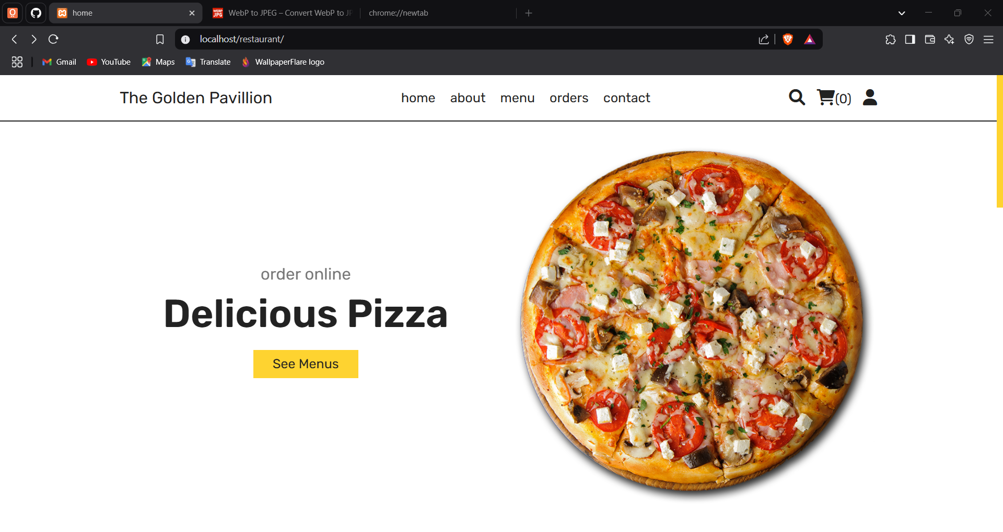
Homepage:

Slide 42
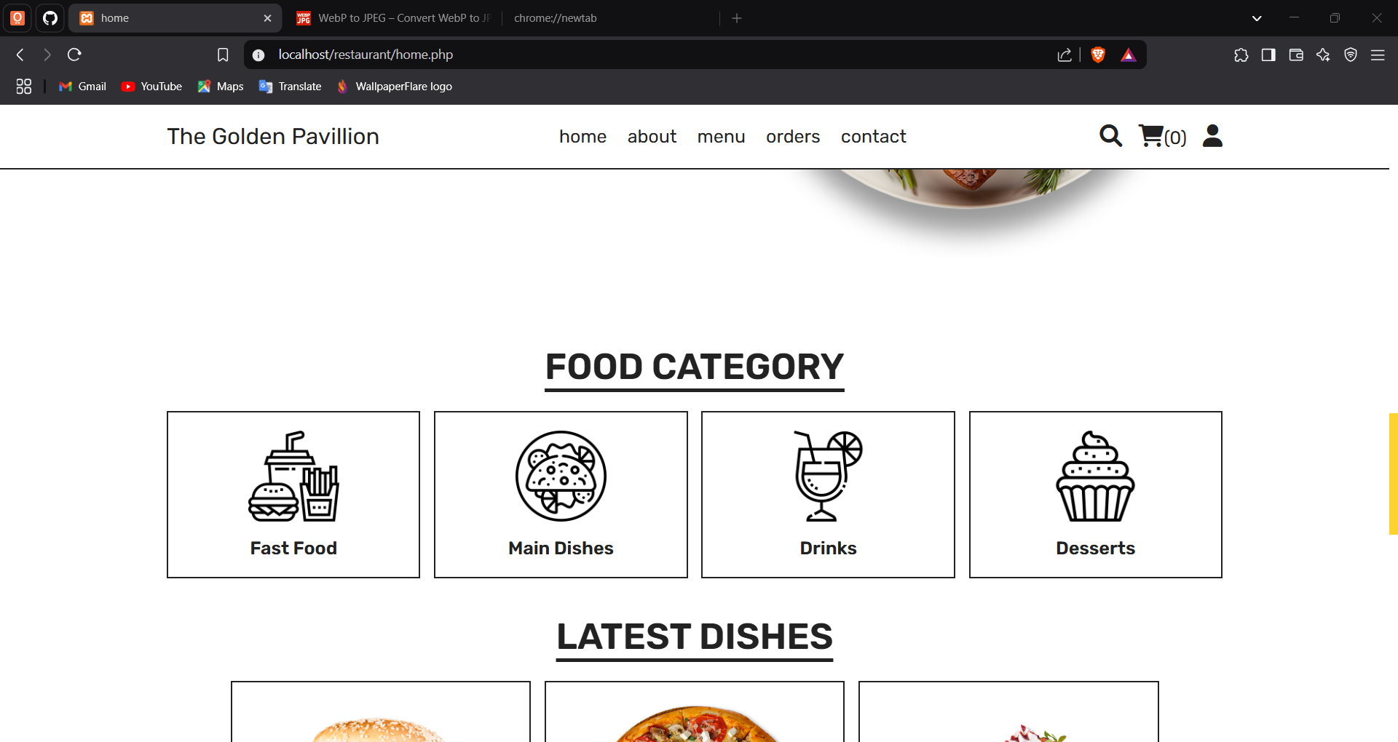
Oder :

Slide 43
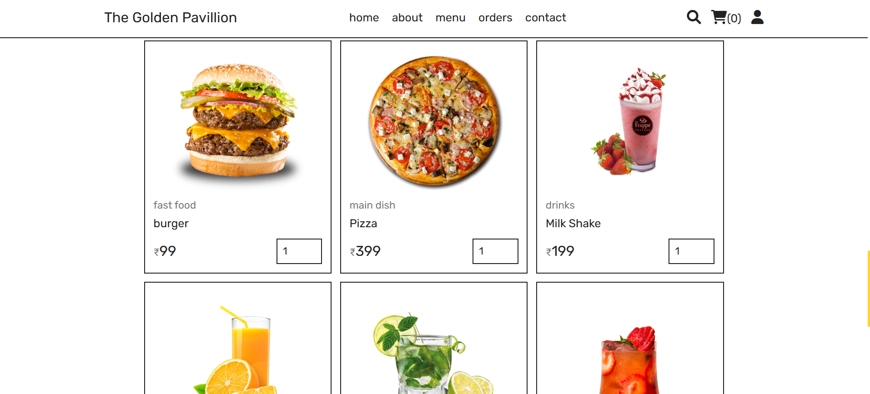
Oder :

Slide 44
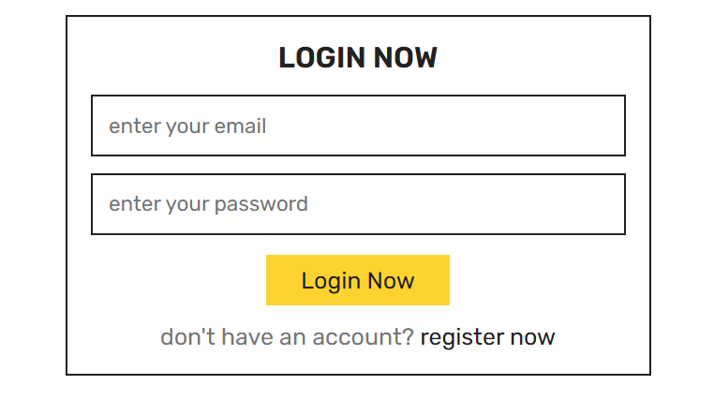
Login page:

Slide 45
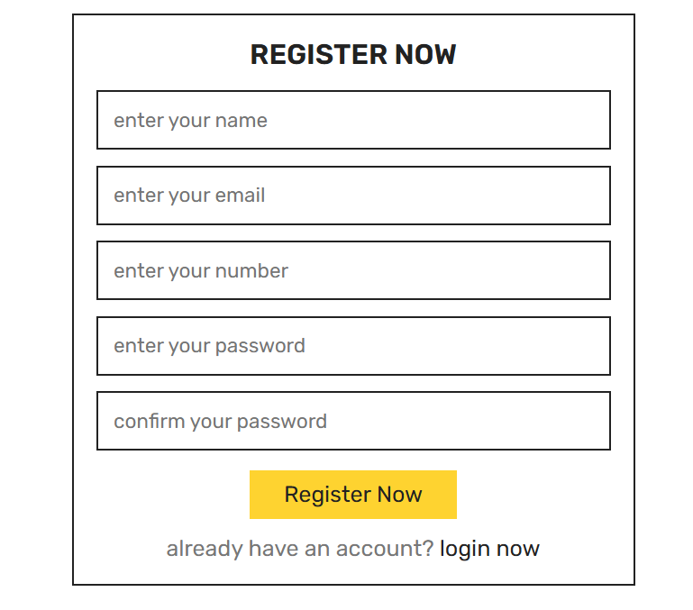
Resgister Page:

Slide 46
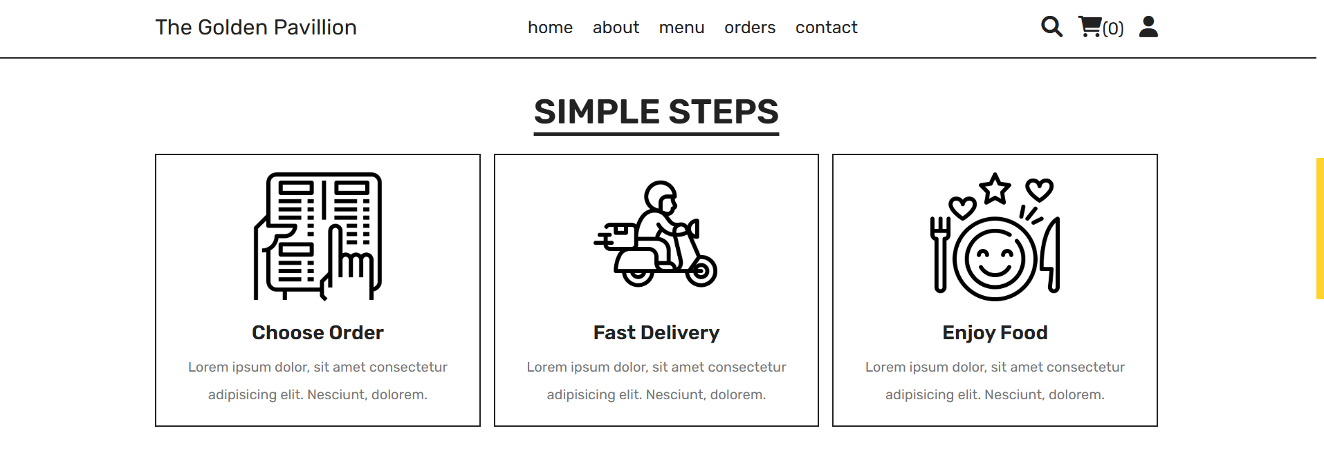
About Us Page:

Slide 47
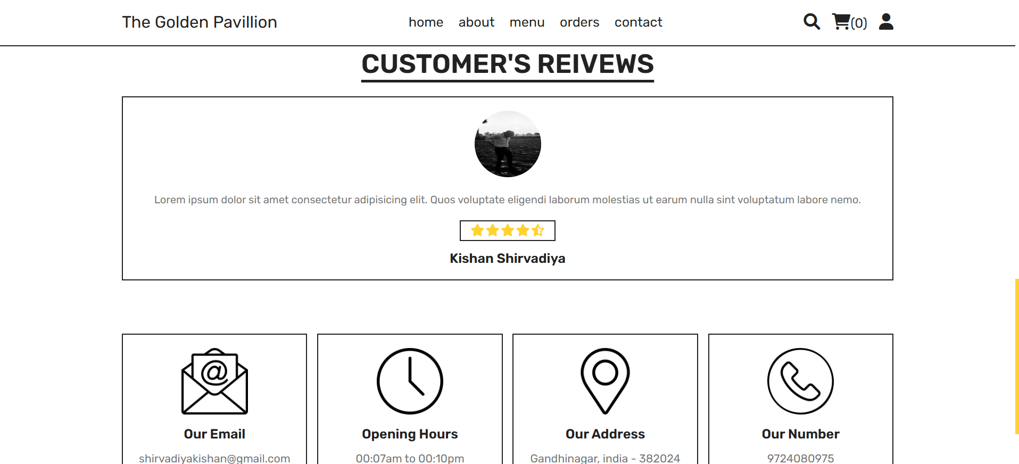
About Us Page:

Slide 48
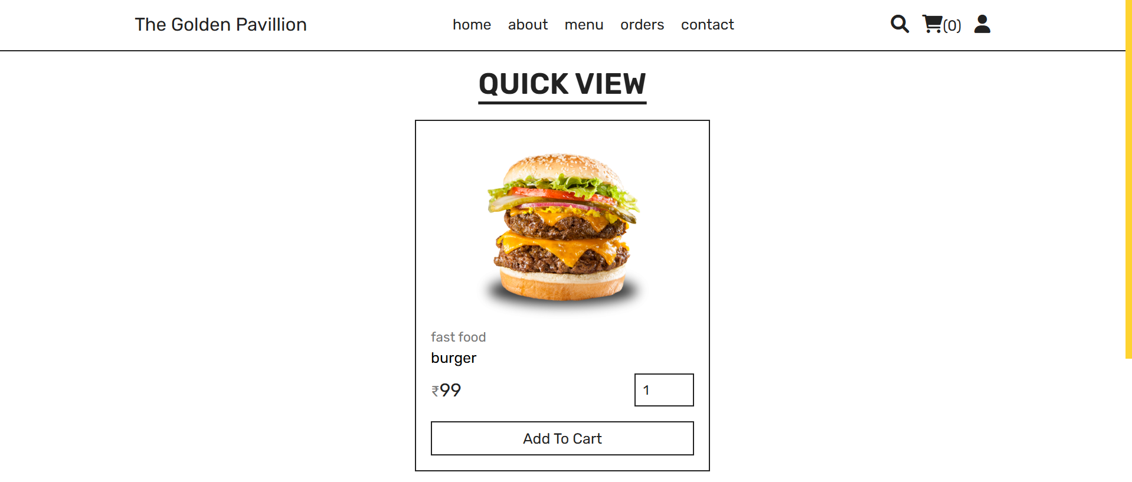
Quick View Page:

Slide 49
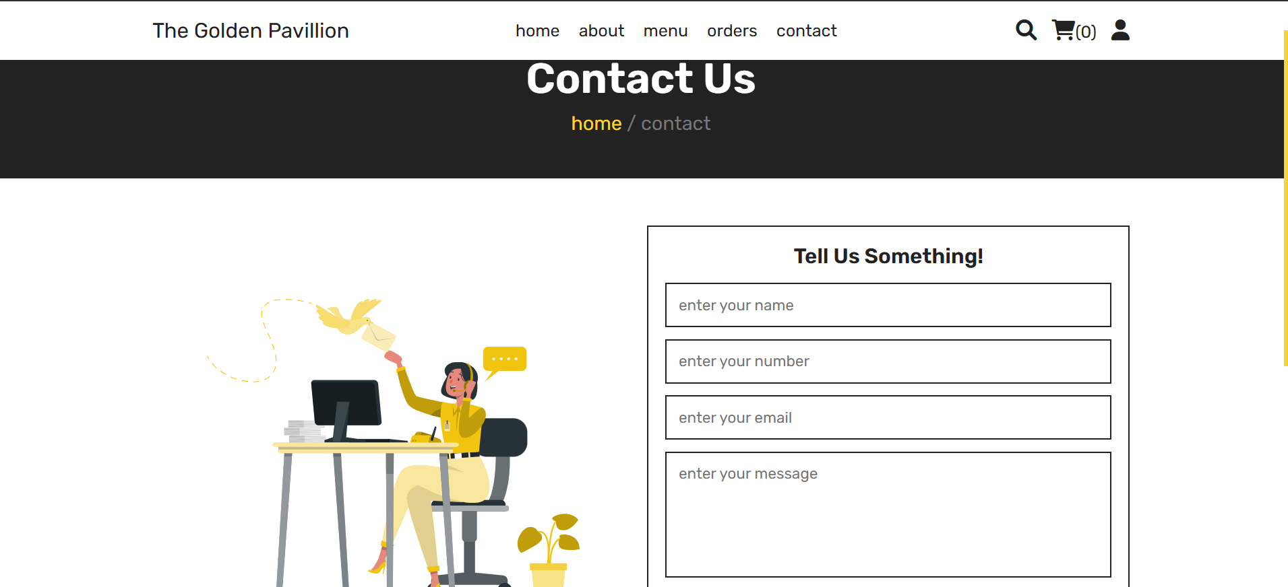
Contact Us Page:

Slide 50
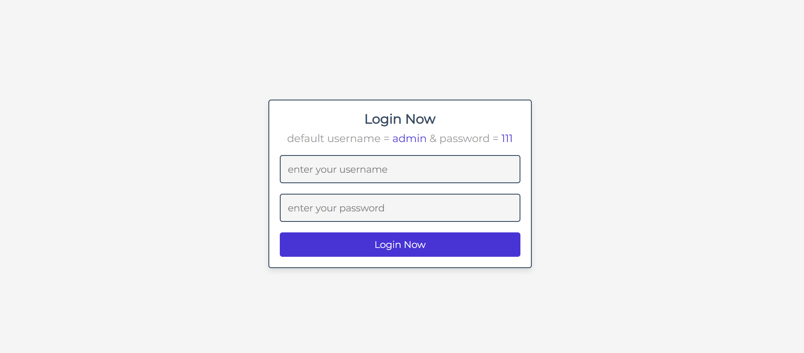
Admin login Page:

Slide 51
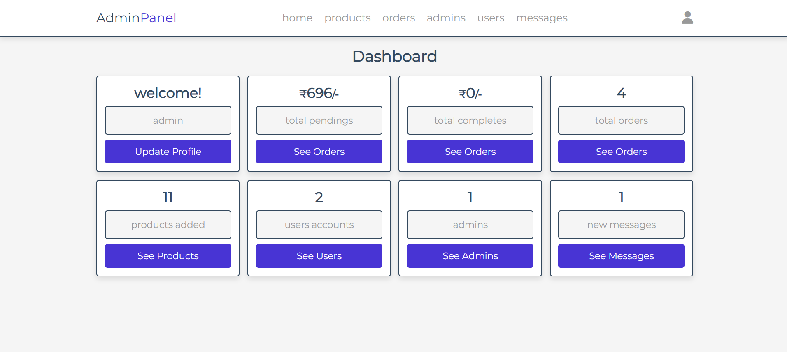
Admin Dashboard Page:

Slide 52
THANK YOU

